Slide 1
Segmentation
Computer Vision

Slide 2
K-means Segmentation

Slide 3
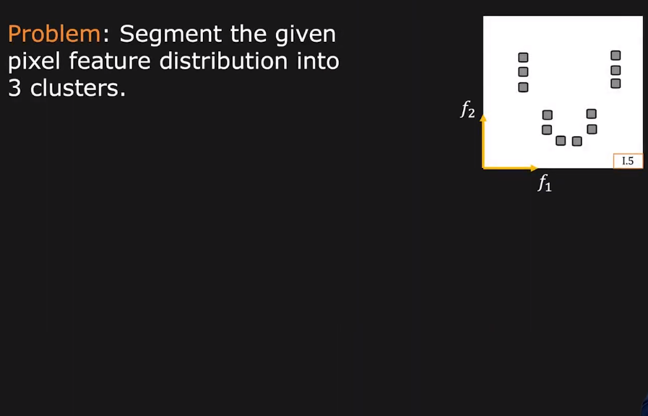
3-Means Clustering Example

Slide 4
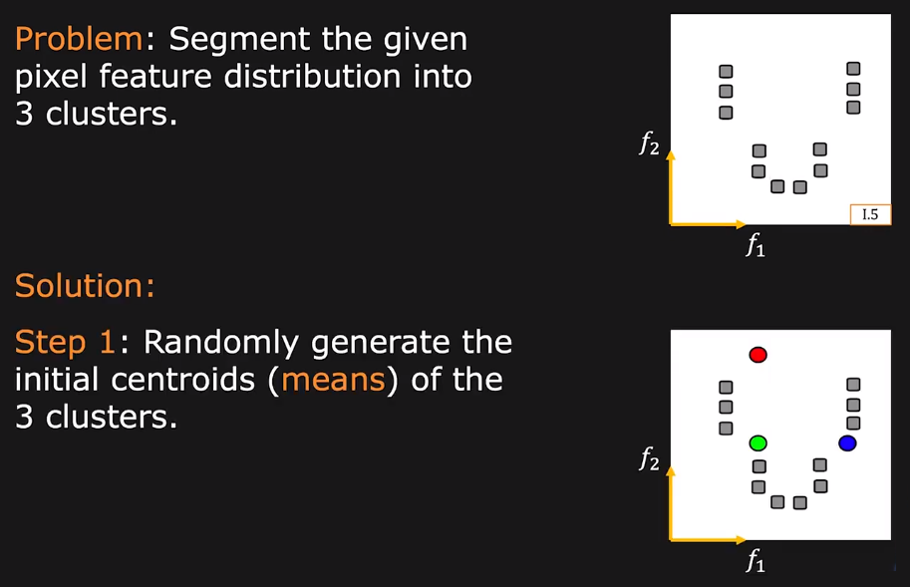
3-Means Clustering Example

Slide 5
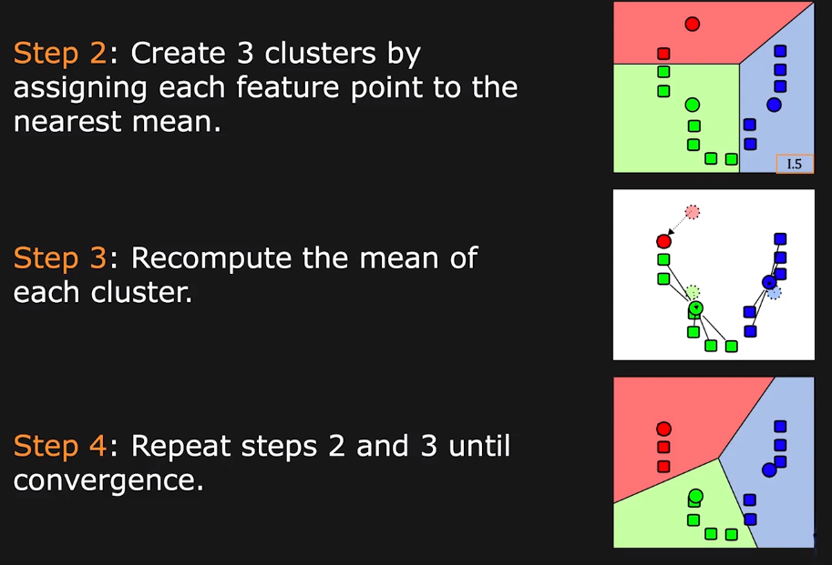
3-Means Clustering Example

Slide 6
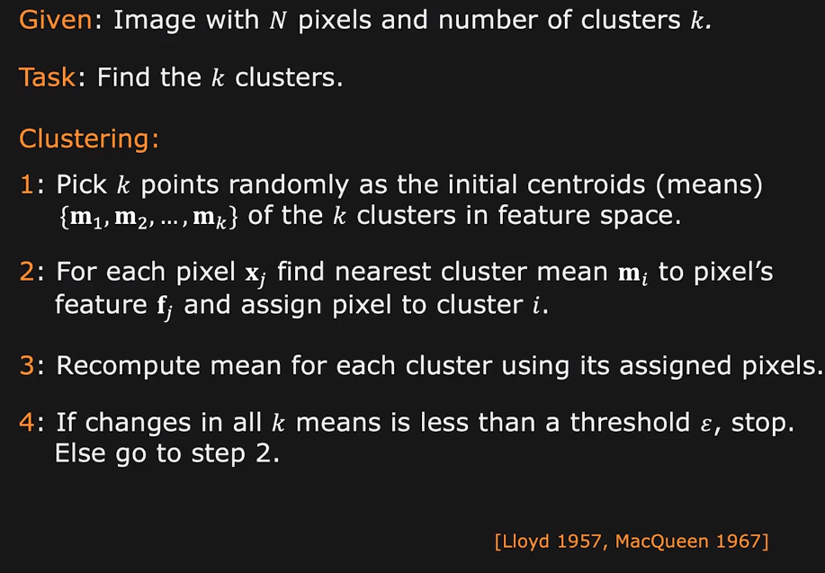
k-Means Clustering

Slide 7
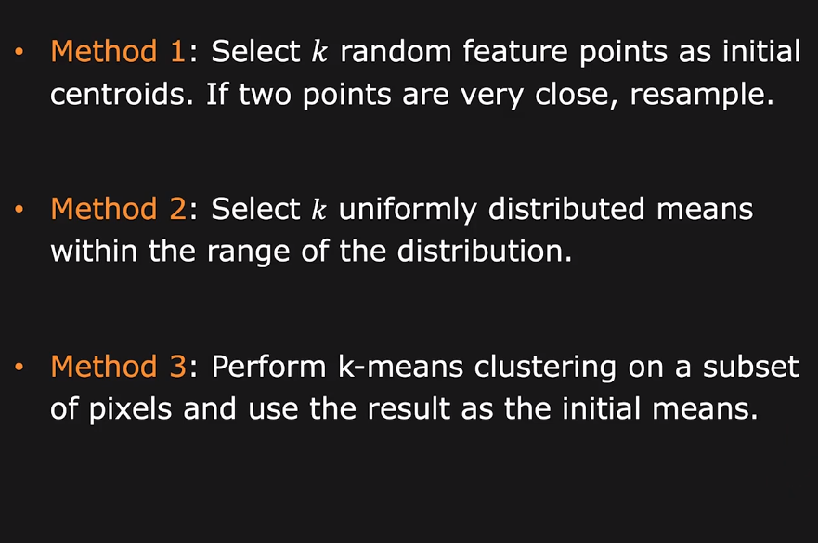
k-Means Clustering

Slide 8
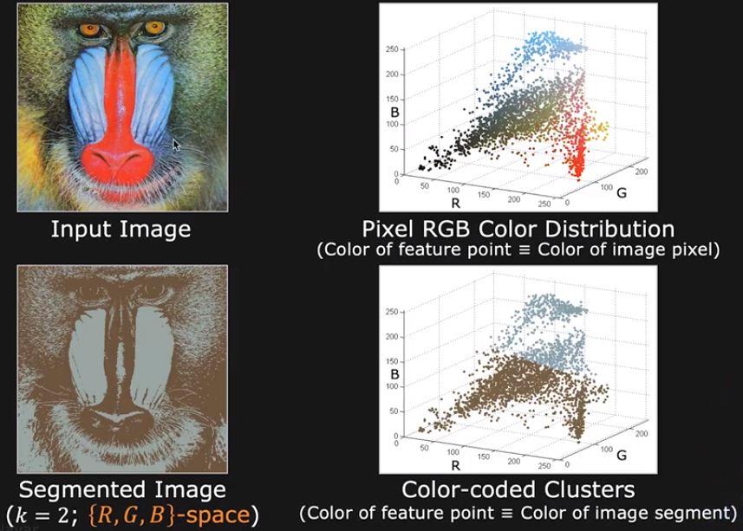
k-Means Clustering (K=2)

Slide 9
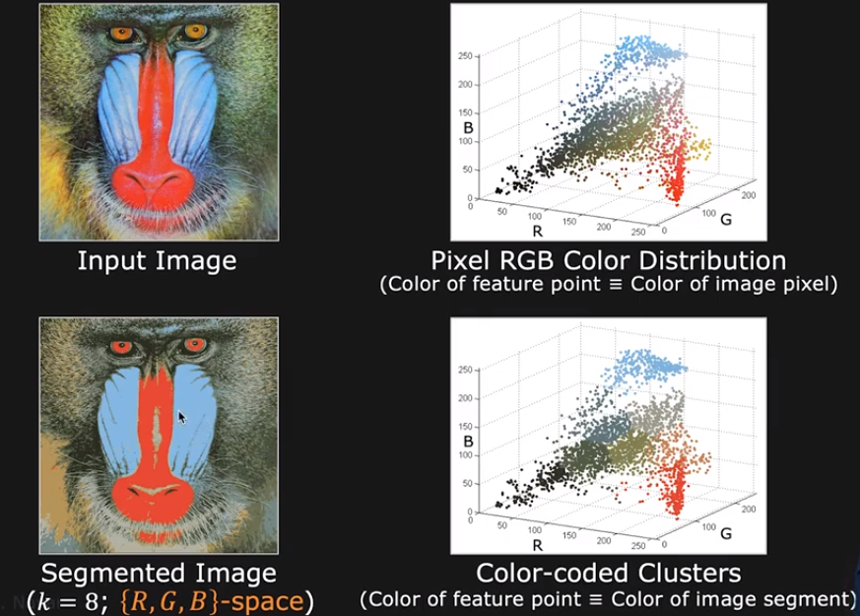
k-Means Clustering (k=8)

Slide 10
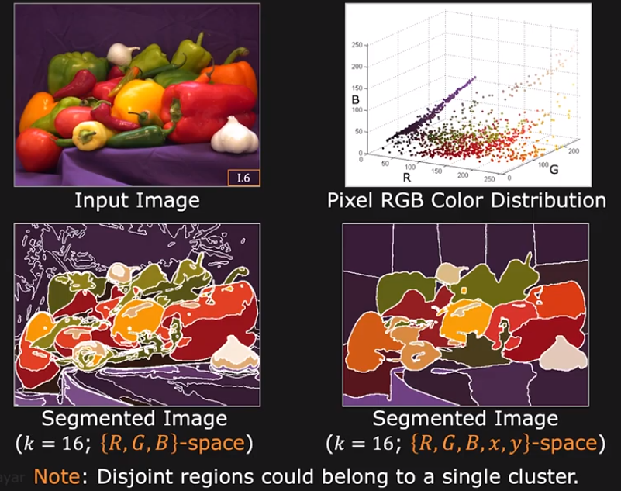
k-Means Clustering (k=16)

Slide 11
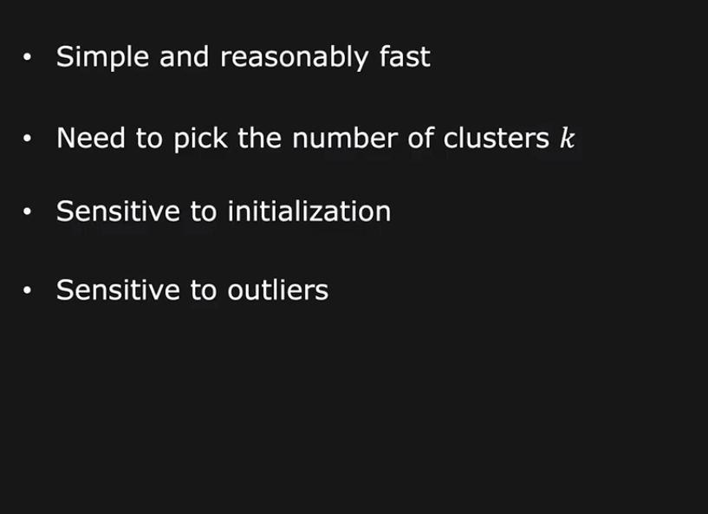
k-Means Clustering

Slide 12
Mean Shift Segmentation

Slide 13
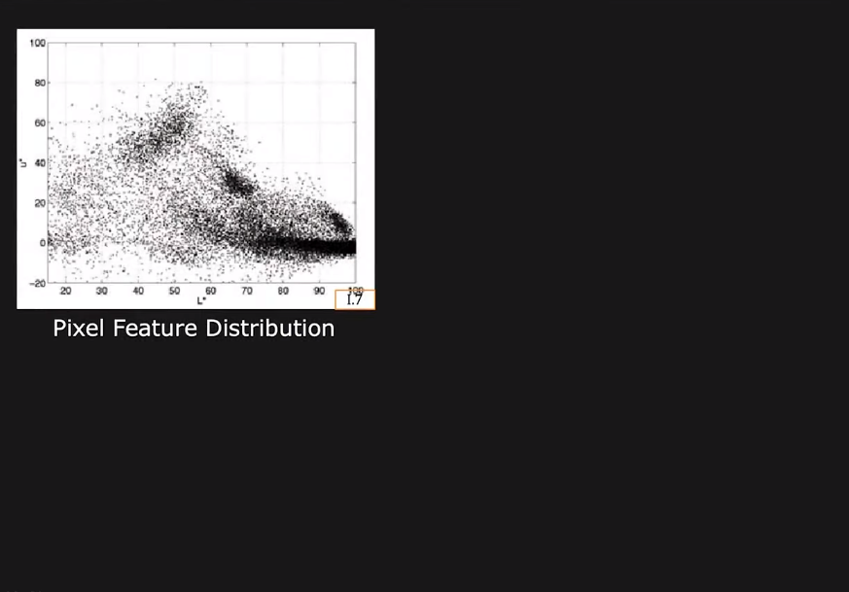
The Concept of Mean Shift

Slide 14
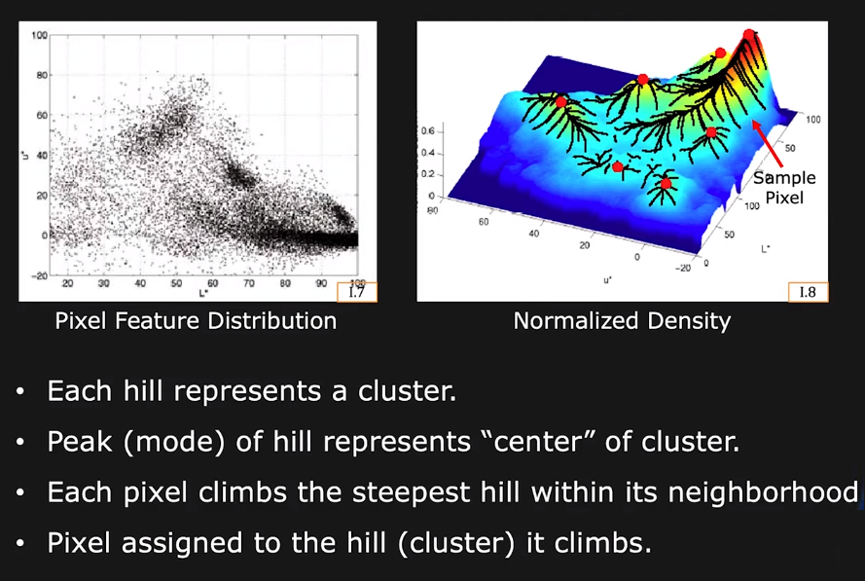
The Concept of Mean Shift

Slide 15
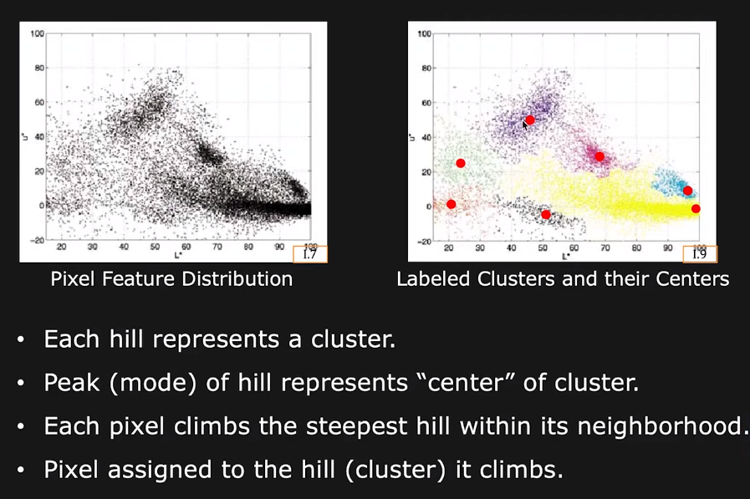
The Concept of Mean Shift

Slide 16
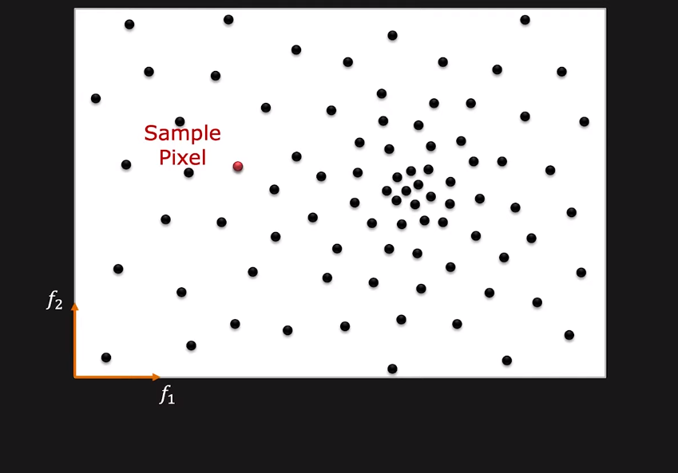
Hill Climbing using Mean Shift

Slide 17
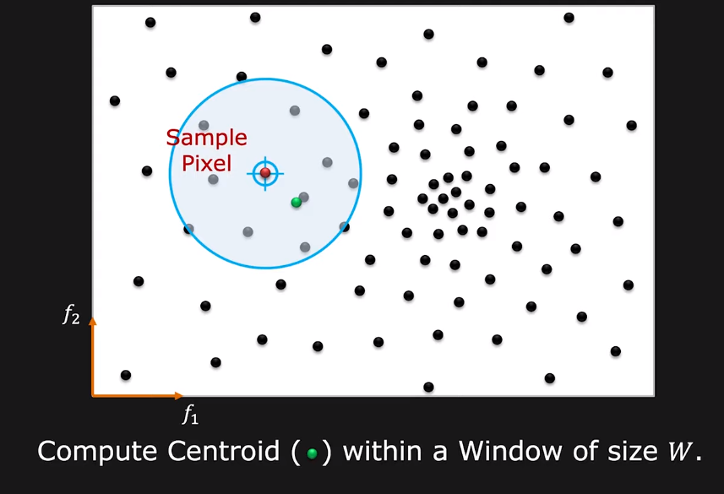
Hill Climbing using Mean Shift

Slide 18
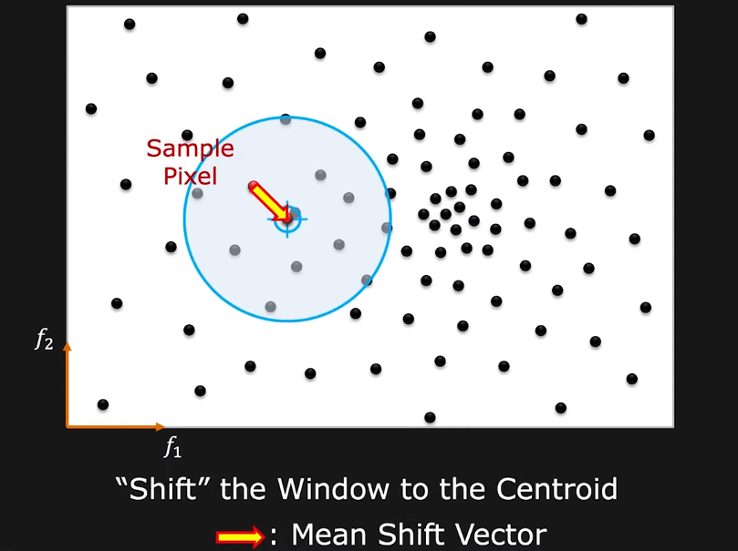
Hill Climbing using Mean Shift

Slide 19
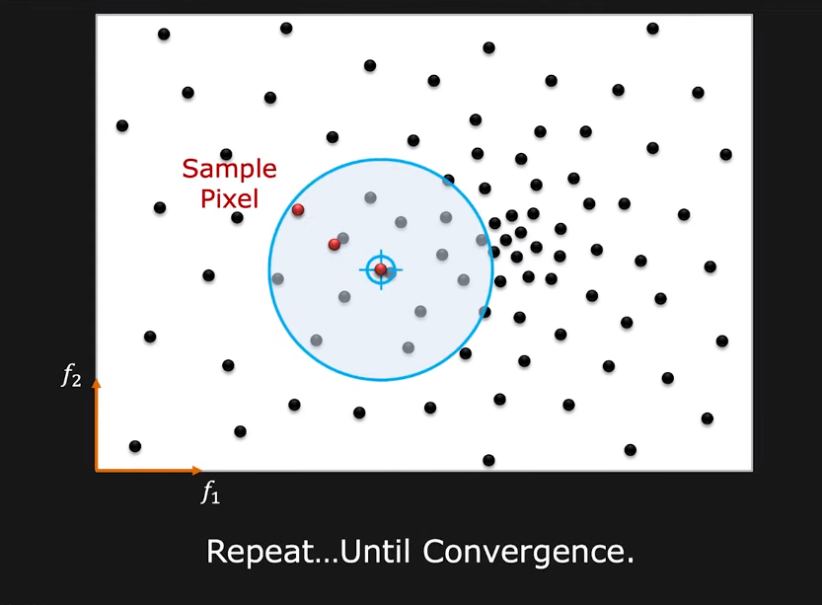
Hill Climbing using Mean Shift

Slide 20
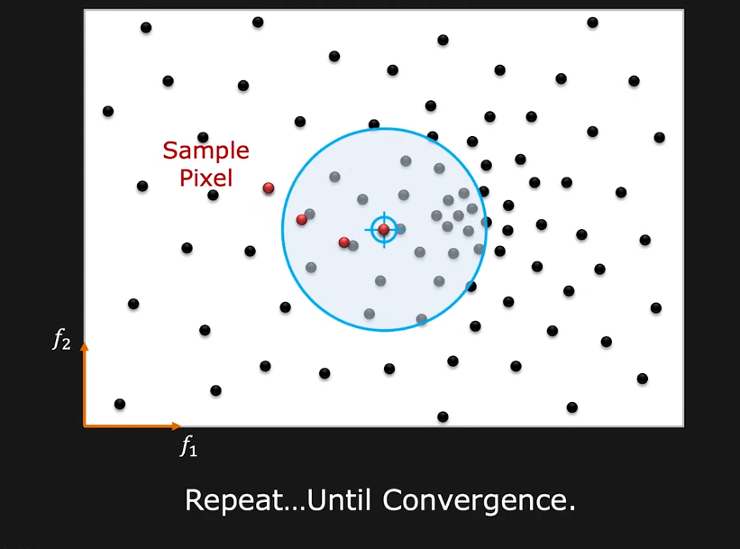
Hill Climbing using Mean Shift

Slide 21
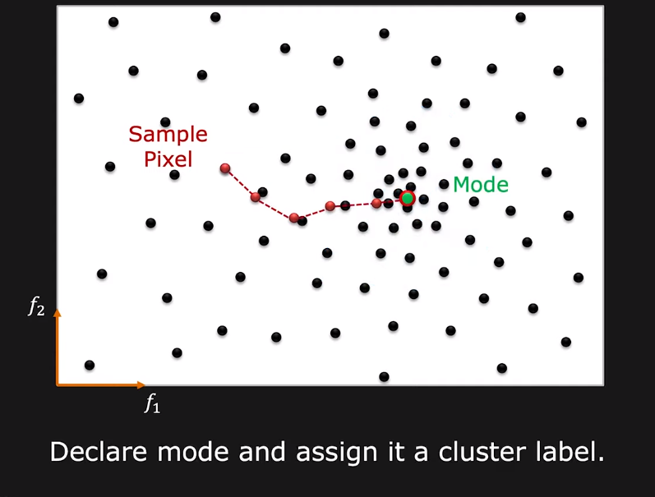
Hill Climbing using Mean Shift

Slide 22
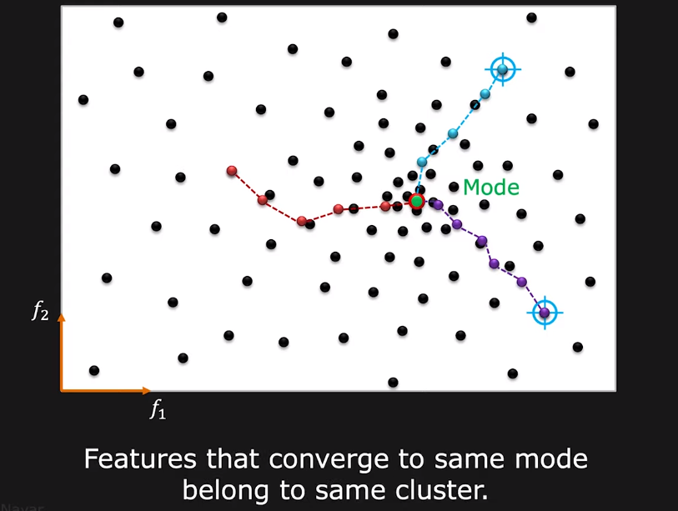
Hill Climbing using Mean Shift

Slide 23
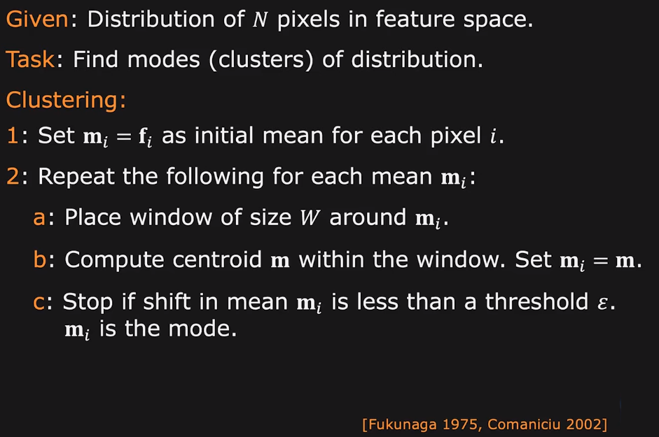
Mean Shift Algorithm

Slide 24
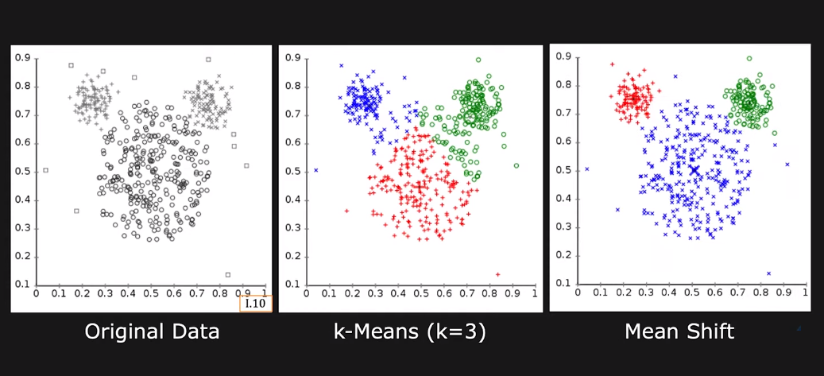
K-means Vs Mean Shift

Slide 25
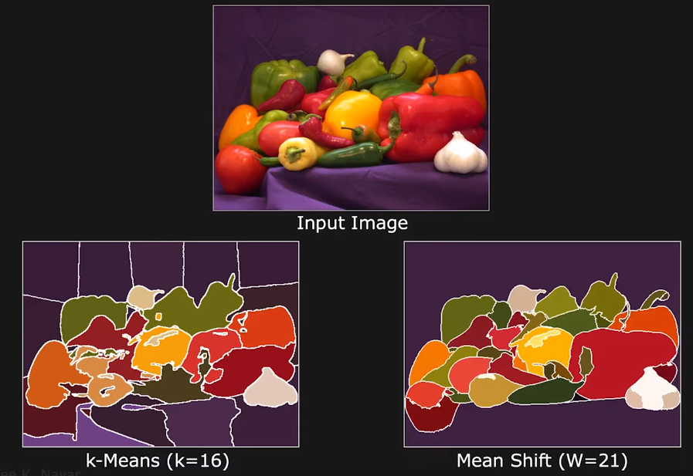
K-means Vs Mean Shift

Slide 26
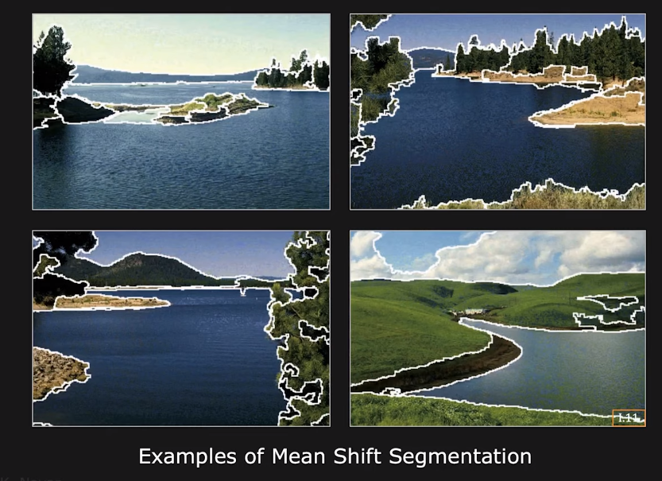
Mean Shift Segmentation Results

Slide 27
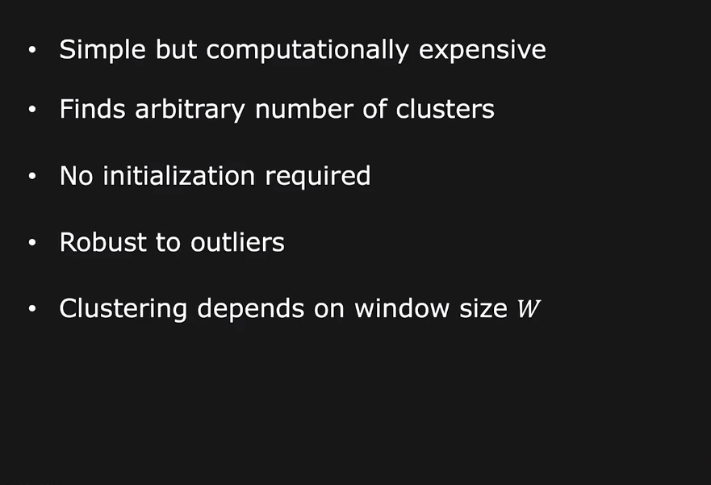
Mean Shift: Comments

